Slide 1

Vel Tech Rangarajan Dr. Sagunthala R&D Institute of Science and Technology
School of Computing
Department of Computer Science and Engineering
10211CS224 / FULL STACK APPLICATION DEVELOPMENT (JAVA)
PROJECT REVIEW : MILESTONE PROJECT – 1
Date: 09-03-2026
PROJECT TITLE
SDG: SDG No – SDG Title(Example: SDG 4 – Quality Education)
Presented By:
K.LEELA LASYA PRIYA– VTU26551 – 23UECS1088.
Courses Handling Faculty:
Dr. S . HEMAMALINI – M.E., Ph.D.,

Slide 2
INTRODUCTION
Online learning platforms have become an essential part of modern education. Students require flexible access to learning resources such as video lectures, notes, and quizzes from anywhere. Traditional classroom learning alone cannot always meet the needs of today's digital learners. Therefore, an efficient online learning system is necessary to support interactive and accessible education. SkillForge is an online learning management system designed to provide structured digital learning. It allows users to enroll in courses, watch video lessons, download notes, and track their learning progress. The system also includes quizzes and certificate generation to evaluate student performance. Overall, SkillForge aims to create an easy, organized, and effective learning environment for students.
1
2
3
4
5
6
7
8
9

Slide 3
PROBLEM STATEMENT
Existing learning systems often lack a centralized platform for managing courses, lessons, and study materials efficiently. Many students face difficulty accessing organized learning resources in one place. Traditional systems may rely on manual processes for managing course content and tracking student progress. This leads to inefficiency in delivering educational materials and monitoring learning outcomes. Students also require flexible learning environments that allow them to access courses anytime and anywhere. Therefore, there is a need for a simple, reliable, and automated online learning management system. The proposed system aims to provide structured course management with video lessons, downloadable notes, quizzes, and progress tracking. This system improves accessibility, organization, and effectiveness of digital learning.
1
2
3
4
5
6
7
8
9

Slide 4
OBJECTIVE(S)
Objective 1: To design and develop an online learning management system that allows users to access courses, video lessons, notes, and quizzes in a structured way.
Objective 2: To implement a system that tracks student learning progress and improves accessibility to digital learning resources.
1
2
3
4
5
6
7
8
9

Slide 5
PROPOSED SYSTEM
The proposed system is an online learning platform that allows students to access courses, video lessons, notes, and quizzes in a structured way.
It provides a centralized system where users can easily enroll in courses and start learning from anywhere.
Admins can manage courses , upload lessons, videos and study materials through an admin panel.
Students can watch video lectures , download notes , and complete quizzes for better understanding.
The system tracks student progress by marking lessons as completed.
It reduces manual management of course materials and improves organization of learning content.
The platform provides a user-friendly interface for easy navigation and learning.
1
2
3
4
5
6
7
8
9

Slide 6
PROPOSED SYSTEM ARCHITECTURE
Input
User registration and login details.
Course selection and enrollment by students.
Admin inputs course details, lessons, videos, notes, and quizzes.
Student interactions like watching videos and marking lessons as completed.
Processing
The system authenticates users during login.
It processes course enrollment and lesson access.
Tracks user learning progress and completed lessons.
Manages course content uploaded by the admin.
Database
Stores user information, login credentials, and profiles.
Stores courses, lessons, videos, notes, and quiz details.
Maintains student progress and enrollment data.
Database used: MySQL.
Output
Displays available courses to users.
Shows video lessons, downloadable notes, and quizzes.
Displays progress tracking and completion status.
Provides certificates or completion confirmation.
1
2
3
4
5
6
7
8
9

Slide 7
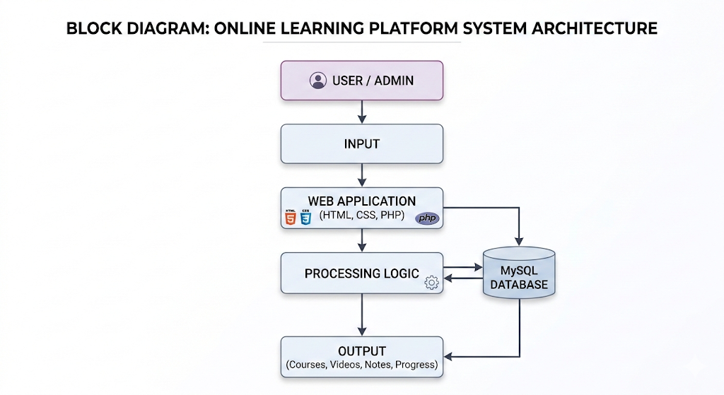
PROPOSED SYSTEM ARCHITECTURE
1
2
3
4
5
6
7
8
9

Slide 8
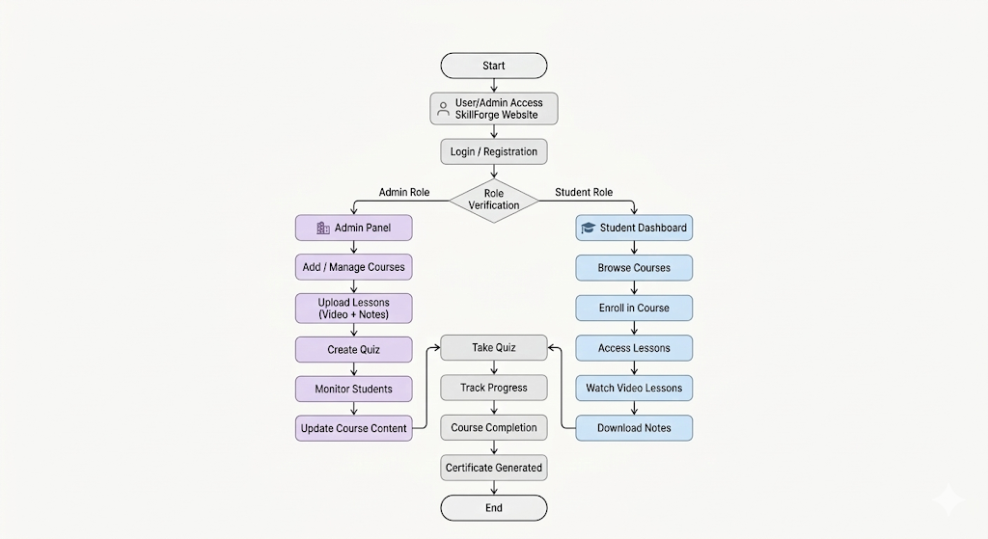
WORKFLOW
1
2
3
4
5
6
7
8
9

Slide 9
TECHNOLOGIES USED
Frontend:
HTML : Structure of the web pages
CSS : Styling and layout design
JavaScript : Client-side interactivity and dynamic content
Backend:
PHP : Server-side scripting to handle application logic, user authentication, course management, and data processing.
Database:
MySQL– Used to store and manage system data
Tools:
XAMPP – Local server environment for running Apache, PHP, and MySQL
Visual Studio Code – Code editor for development
phpMyAdmin – Database management tool for MySQL
Web Browser (Chrome/Edge) – For testing and running the application
1
2
3
4
5
6
7
8
9

Slide 10
MODULE DESCRIPTION
----- Example for reference only ---- (Change according to your project)
Module 1: User Management
Handles user registration, login, and authentication for both students and administrators..
Module 2 Course Management
Allows the administrator to create, update, and manage courses.
Module 3: Learning & Enrollment System
Enables students to browse available courses and enroll in them.
Module 4: Quiz & Progress Tracking
Provides quizzes for evaluating student understanding after lessons.
Module 5: Certificate Generation
Generates certificates automatically when a student completes all lessons and assessments in a course.
1
2
3
4
5
6
7
8
9

Slide 11
IMPLEMENTATION SCREENSHOTS
(Add screenshots of:
Home page
Login page
Main module
Output page)
Explain each in 1–2 lines.
1
2
3
4
5
6
7
8
9

Slide 12
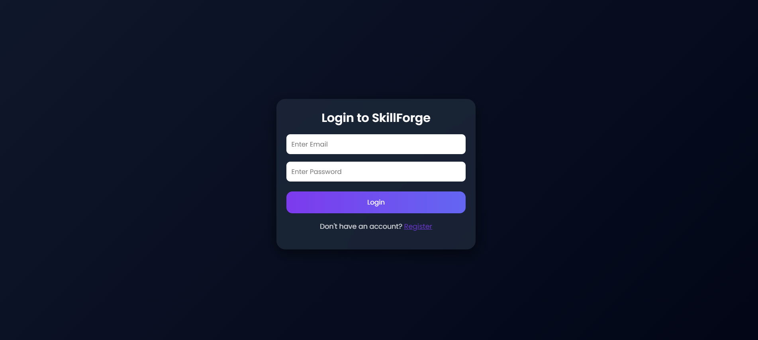
IMPLEMENTATION SCREENSHOTS
Login page
1
2
3
4
5
6
7
8(A)
9

Slide 13
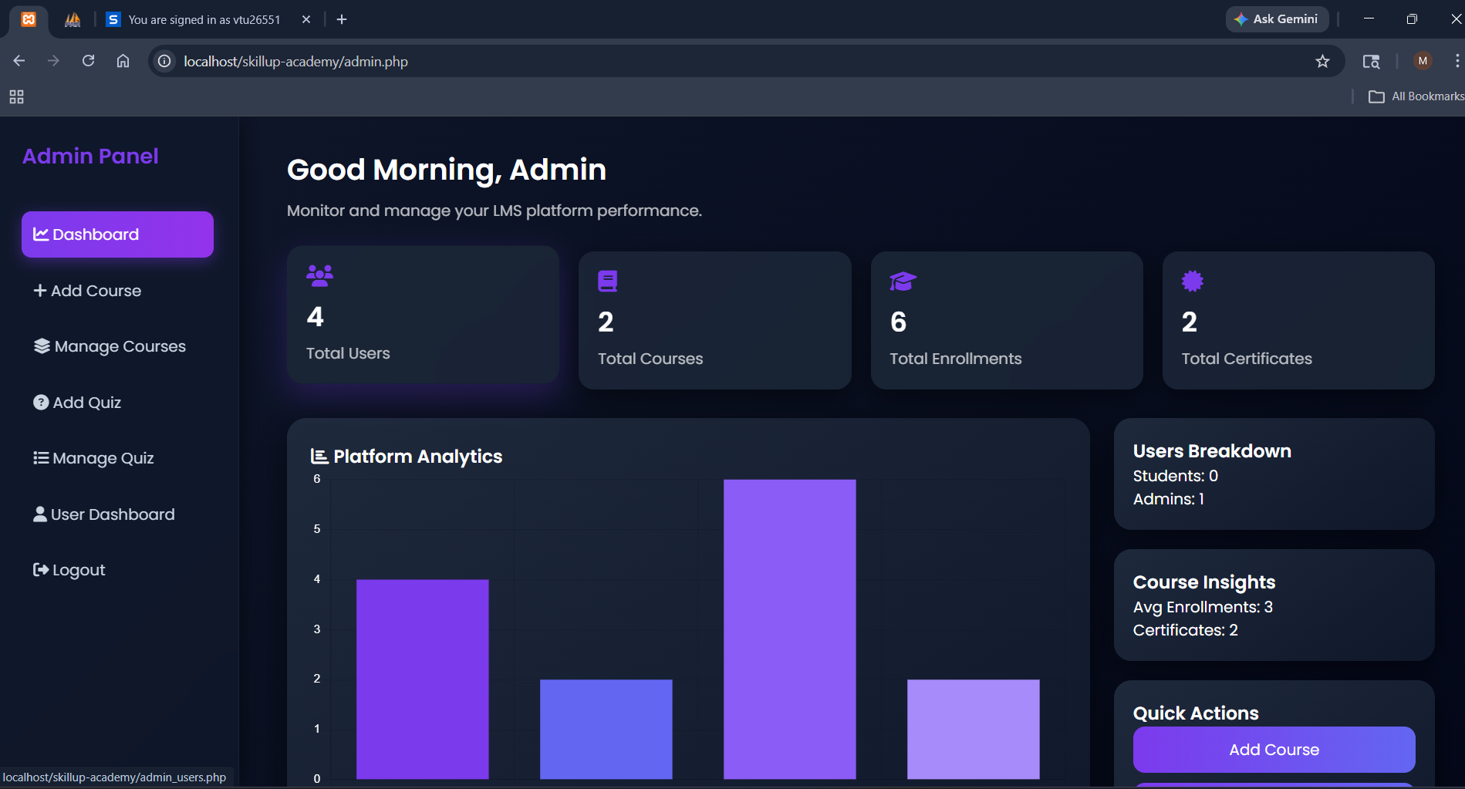
IMPLEMENTATION SCREENSHOTS
Admin Home Page:
1
2
3
4
5
6
7
8(B)
9

Slide 14
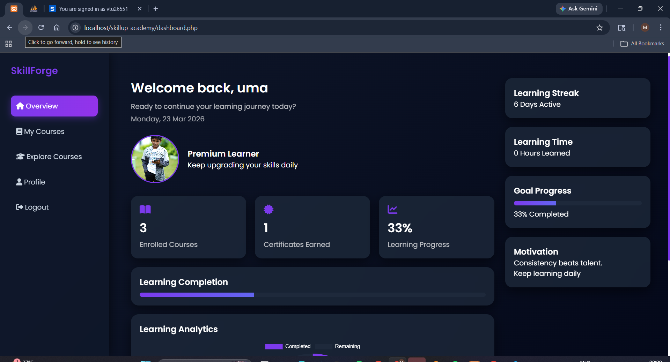
IMPLEMENTATION SCREENSHOTS
User home page:
1
2
3
4
5
6
7
8(C)
9

Slide 15
ADVANTAGES & LIMITATIONS
1
Advantages
Easy access to courses anytime, anywhere
Organized learning materials (videos & notes)
Automatic progress tracking
Simple course management for admin
Quiz and certificate support
Limitations
Requires internet connection
Limited offline access
Basic security features
Not optimized for very large users
Needs more advanced features in future
2
3
4
5
6
7
8
9

Slide 16
Thank you

